Slide 1
Coming Soon

Slide 2


Slide 3


Slide 4
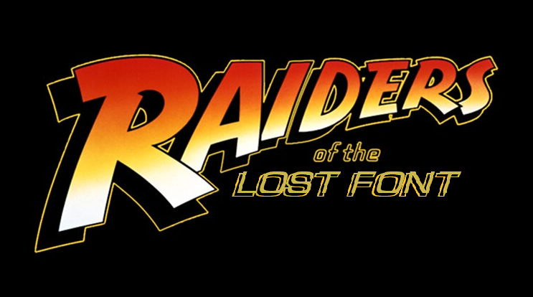

Slide 6


Slide 7

Notes:
Oh. Hello there.
I apologize. Dr. Jones could not be here today. He found himself in a rather… tricky… situation.
But rest assured, you’re in good hands. He sent me in his place to talk about one of our recent adventures.
My name is Bob Lamaster. I’ve been side-by-side with Dr. Jones all around the world. Trust me… I’ve seen a lot.
But before we get into that… a little about me. (click)

Slide 8

Texas, USA
First-time presenter
1 dog, 1 cat, 1 wife
Hobbies include:
Home automation
Playing the slots
3D Printing
Power Platform
Notes:
I’m from Texas. I’m a first-time presenter…
So now, let’s get into our story. (click)

Slide 9
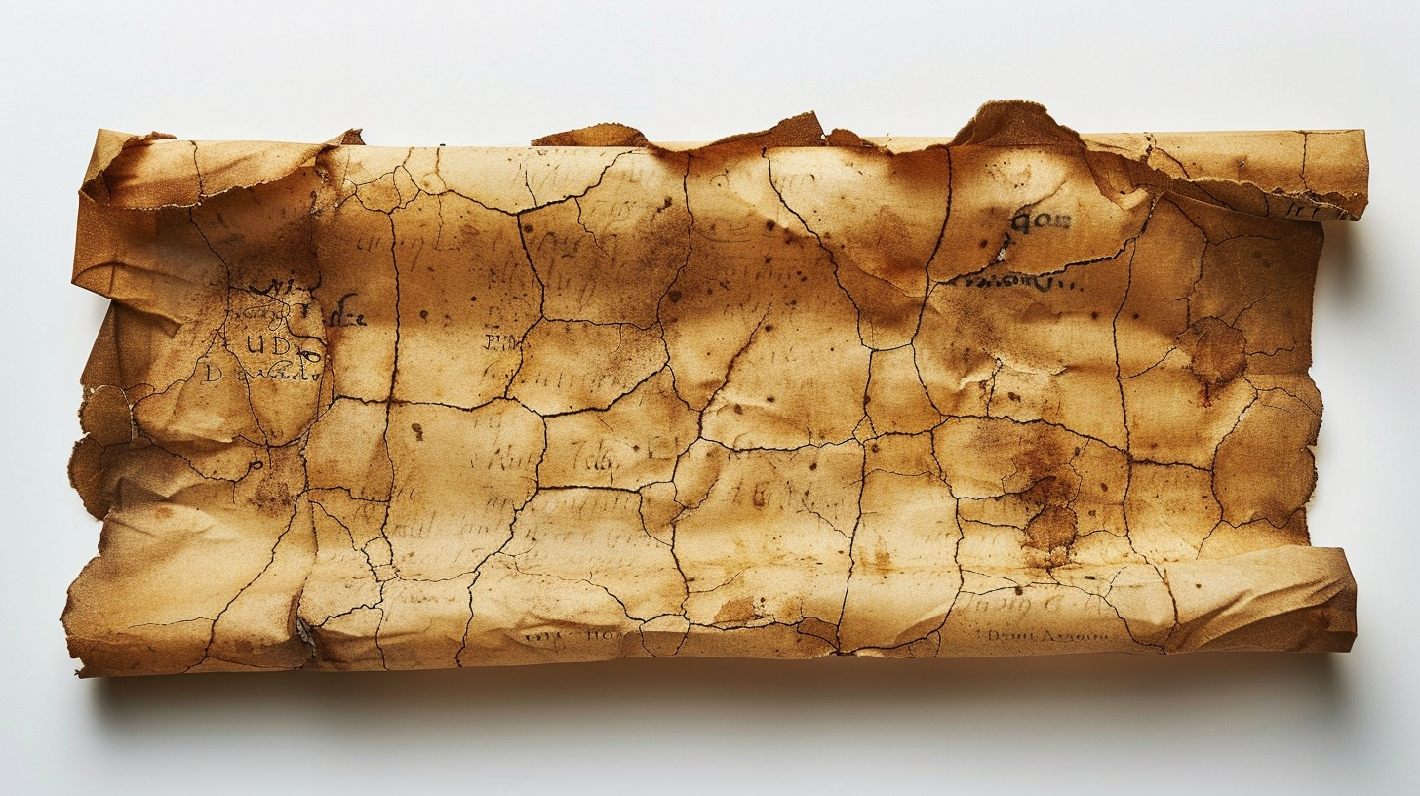
Act I: The Ancient Mysteries
Discovering early custom font techniques in Power Apps
Notes:
Our story starts off, like most stories do, with a quest.
That quest, is to break out of the limitations of the 14 fonts included within Power Apps. Dr. Jones and I had a few leads on the location of some ancient wisdom that could possibly overcome those limitations.
So, we set off on our adventure. (click)

Slide 10


Slide 11

Notes:
Our first lead brought us to the Temple of Locality. After much searching, we came upon a pedestal with a small dusty scroll atop it. As we unrolled the scroll, we were astonished to find it quite legible.
The scroll described an ancient practice of using locally-installed fonts in PowerApps. (click)

Slide 12

Solving the ancient mystery:
LOCALLY-INSTALLED FONTS
Creative Solution
Use installed fonts on your computer!
How to do it
Instead of specifying “Font.<name of built-in font>” in the formula bar (or choosing it from the drop-down), simply type the name of a font you’ve already installed on your computer.
Notes:
We discovered that you can simply write your formula a little bit differently and use ANY font on your local machine. (click)

Slide 13

SOLVING THE ANCIENT MYSTERY:
Built-in:
Locally installed font:
Installed font name Fallback font name
Initial Limitations
Power Apps initially offered limited font options, restricting design creativity for developers and users.
Creative Solution
Use installed fonts on your computer!
How to do it
Instead of specifying “Font.<name of built-in font>” in the formula bar (or choosing it from the drop-down), simply type the name of a font you’ve already installed on your computer.
Notes:
It was quite simple, really! Was this the holy grail? (click)

Slide 14

Method 1 – Local Fonts: The Font That Was There… Until It Wasn’t
It was a trap!
Dependency on User Devices
Local fonts depend on fonts installed on each user's device, which can vary widely.
Unreliable Font Availability
Font availability is inconsistent, causing layout and display issues across platforms.
Notes:
Alas, we soon discovered that locally-installed fonts were a TRAP!
They only work if everyone is using the same operating system, the same device type, and has the same fonts installed.
Fortunately, we had avoided that trap and were off to pursue our next lead. (click)

Slide 16


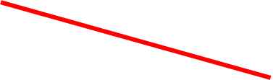

Slide 17

Notes:
This lead was more difficult to follow-up. We had heard stories of a mystic language of symbols that somehow enabled custom fonts. Eventually, deep in the jungle, we found what we were looking for - the Temple of Glyphs.
Rumor was that this temple contained the secret of an arcane language, called “Base64” (or something like that), that could be embedded directly in PowerApps. (click)

Slide 18
Solving the ancient mystery:
EMBEDDING CUSTOM FONTS
SVG fonts encoded in base64 strings allow embedding custom fonts directly inside applications.
Creative Solution
Convert fonts to an SVG image and simply put the image on your canvas!
How to do it
Download a font
Use an online font converter to translate the font into an SVG stylesheet
Use the stylesheet code as the source of the image in your app
Notes:
We discovered the scroll we were looking for, but the language was strange and confusing at first. After Dr. Jones translated it, we saw a complicated process of font download, conversion, formula manipulation, and image injection. (click)

Slide 19

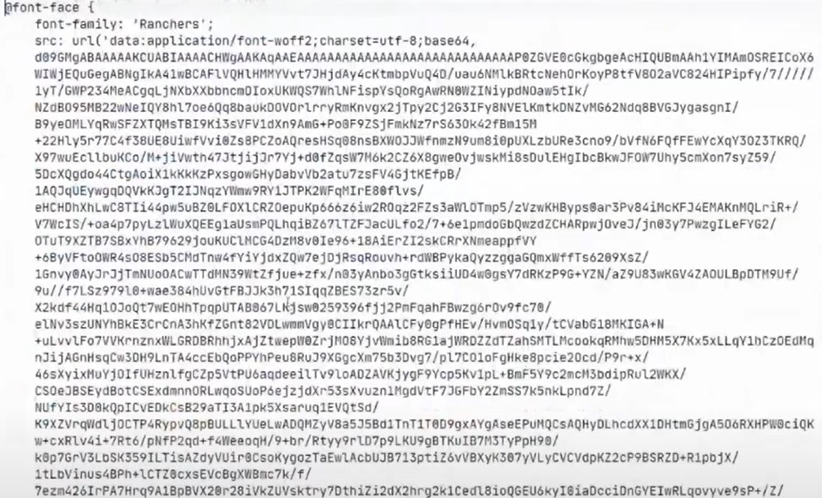
Solving the ancient mystery:
EMBEDDING CUSTOM FONTS
SVG fonts encoded in base64 strings allow embedding custom fonts directly inside applications.
Creative Solution
Convert fonts to an SVG image and simply put the image on your canvas!
How to do it
Download a font
Use an online font converter to translate the font into an SVG stylesheet
Use the stylesheet code as the source of the image in your app
Notes:
It really looked like some childhood gibberish, and it really made my head hurt. (click)

Slide 20

Method 2 – EMBEDDING SVG FONTS: A LOT OF EFFORT AND BLOAT
It was a trap!
Heavy Payload Issue
Embedding fonts as base64 increased payload size significantly, impacting app performance.
Maintenance Challenges
Managing base64 embedded SVG fonts complicated maintenance and updates of applications.
Notes:
Again, we were met with a TRAP!
While the fonts would be visible on all operating systems and devices, such a complicated process wasn’t scalable, especially because it added significant bloat to our apps!
What to do? What to do?
There must be a real solution for getting external fonts into PowerApps. If only…
There was only one more lead to pursue. Although still weary from our journey, we set out again. (click)

Slide 23


Notes:
What’s this? As we approached our final stop, there was a golden glow in the distance. We pulled-in closer and discovered a breathtaking cache of precious gems, gleaming treasure, and a single scroll.
Dr. Jones gently unwrapped the scroll and all of our prayers were answered. Maybe not the holy grail, but probably a close second. (click)

Slide 24

AN ACIENT SCROLL REVEALED:
The font loader!
What is the answer to this ancient puzzle?
DON’T EMBED YOUR FONTS IN YOUR APP!
Huh? Then how am I supposed to show my fonts?
USE THE FONT LOADER!
What the heck is the font loader?
IT’S A MODULE!
IT’S A CONTROL!
IT’S A DEMO!
IT SLICES! IT DICES! IT MAKES JULIENNE FRIES!
IT’S ALL THAT AND MAYBE MORE!
Notes:
--- Recognizing the pain points of previous methods, the Font Loader approach emerged as a more efficient and scalable solution for integrating custom fonts in Power Apps. Image source: Microsoft 365 content library

Slide 25
The font loader
IT’S A MODULE
If you’re creating your own PCF controls, it’s a small file that fetches fonts from Google (or another CDN) AT RUNTIME.
IT’S A CONTROL
If you’re an app maker, but NOT creating PCF controls, (because – let’s face it – It’s not for everyone) and simply want to put external fonts in your canvas app, just plug-in the Font Loader Control and use it instead of the built-in TEXT or LABEL controls.
IT’S A DEMO
Well of course I’m going to show it to you. Shield your eyes, though. This could be like the Ark of the Covenant. Only the worthy should gaze upon it.
Notes:
(click)
As a module you can use when authoring PCF controls, it fetches fonts AT RUNTIME. In other words, your fonts aren’t even IN your app until your page loads. No more failed attempts to include fonts! (click)
As a control, Makers can simply use it in place of TEXT or LABEL controls whenever custom text is needed… without bloating your page code. (click)
Finally, as a demo… that’s what we’re here for, but beware… It could be like the Ark of the Covenant. You may need to shield your eyes from its awesome power. (click twice)

Slide 26
DEMO TIME!
Notes:
Demo Time! [DO NOT CLICK]

Slide 27

Where can I get it?
https://github.com/korebreach/custom-font-controls
Notes:
You’ll find everything you need here, whether you’re looking for a simple control to use in your own projects, want to install the demo, or want to use my module in your own PCF controls.

Slide 28
Credit where credit is due
Eickhel Mendoza
“Learn the many ways to use custom fonts in Power Apps”
Coding
I AM NOT A CODER!
Learning PCF controls through trial and error
Most of my learning has been done through bouncing ideas off Microsoft Copilot, iterating, refining, trying, failing, etc.
Over 2 months trying to put custom fonts into my own project in Power Apps, with the guidance of Copilot, before I found it wasn’t possible to bundle them.
In other words, “Copilot is my copilot!”
Notes:
First of all, a HUGE shout-out to Eickhel Mendoza who demonstrated this method at a C# conference. Without his inspiration, I would have given up. [CLICK]
Second, contrary to what you saw in the demo, I AM NOT A CODER. I must acknowledge and praise Microsoft Copilot for showing me how to do just about everything. [CLICK]
With that… it’s off to the next adventure! [

Slide 29
https://github.com/korebreach/custom-font-controls

